Slide 1
B.A Complaint Registration Guidelines

Slide 2
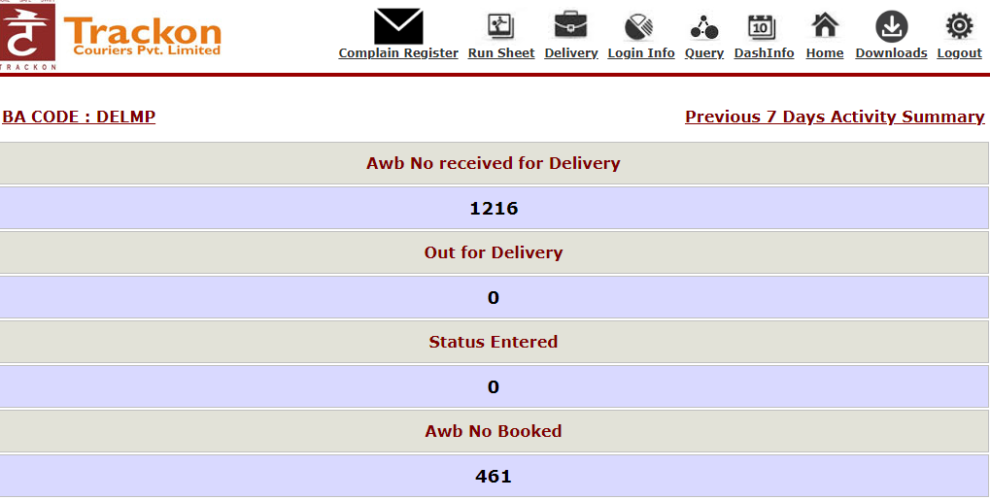

Slide 3
How to Use the First Complaint Request Form ?
Complaint Request Form
Given Six Types Of Complaint Category .
Like :- 1.Undelivered ,2.DRS Required ,3.Misroute ,4.short material ,5.Short Piece ,6.Damage .
2. Fill up the Form To Register the Complaint ,
Like :-First Side Shown , Complainer Details (( Who’s Registering the complaint ))
Second Side Shown ,Receiver Details like Receiver Name and Address ,
Given Remark Option If want to give some more information
Spl.Note - All the Red doted filed are Mandatory to Fill .
After Fill up These Details When Click on submit The Complaint Number Will be shown on screen and The Same Complaint Number Will Receive On the Complainer Mobile through the SMS.
3. If Select complaint category (( DRS Required , short material , Damage )). EMAIL –I.D mandatory .

Slide 4
How to use the Change Address complaint Form
Change Address Form
1. Change Address Request Form .
2.Upper Side Consignment Number and Complainer details Required .
3.First Side Old address details Required and Second Side New address details Required .
Instruction :- If the Consignment is Non-dox and Want to change address It will be Chargeable and the Same Instruction will be shown on the Screen when Registering the Change Address Complaint .

Slide 5
How to use the Hold Complaint Form
HOLD / RESEND / RTO
Form for Hold /Resend /RTO . First Form for Hold.
Upper Side Consignment Number and Complainer details Required .
Fill up the Receiver details .
Select the Drop Down of Reason For Hold .
5. Select the Hold Date .
Information : - Can Select Hold Date Till One Week From The Date Of Complaint .

Slide 6
How to use the Resend complaint Form
RESEND
Form for Resend .
Upper Side Consignment Number and Complainer details Required .
Down Side Shown Consignment Details and Receiver details .
Information : - If Want to Resend the Consignment It will be Chargeable If Consignment Non-Dox .

Slide 7
How to use the R.T.O complaint Form
rto
Form for R.T.O.
Upper Side Consignment Number and Complainer details Required .
Down Side Shown Consignment Details and Receiver details .
Information : - If Want to Resend the Consignment It will be Chargeable If Consignment Non-Dox .

Slide 8
How to use the Track complaint Form
Track complaint
After Register the Complaint, Insert The consignment or Complaint Number and can check the Complaint Status . And If want to give some more information you can write In Remark/Comment .

Slide 9
THANK YOU

