Slide 1
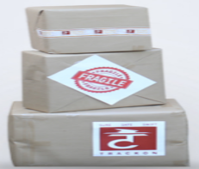



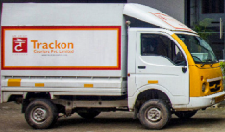
BA PORTAL
[BUSINESS ASSOCIATE]
Created by : Shiva Kashyap
Validated by : Mani Madhukar
Created Date : 12/09/2022
Ba Portal
We provide a safe, diverse and rewarding environment to work

Slide 2
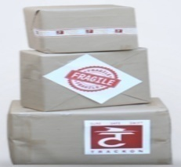
Description
As we know Ba Portal is mainly developed for our Franchise . So that the Franchise remain self-dependent. Such as creating DRS, Status Updates, clearing pendency and viewing pending, Manage Delivery Route , Self Shipment Booking, Do Payment Online and etc..,
The precept behind making this PPT. The new Franchise are not aware of the Ba Portal and they have no knowledge of DRS, Status Updates, Pendency
Due to which some percent of BA users find it difficult to work in BA portal.
I hope that With the help of this PPT , we acquire Knowledge about the all modules .
To The Given Three Steps Mention Below
According to the images of the Modules .
How to use that modules
Some short description/Information about Modules
Ba Portal
We provide a safe, diverse and rewarding environment to work

Slide 3

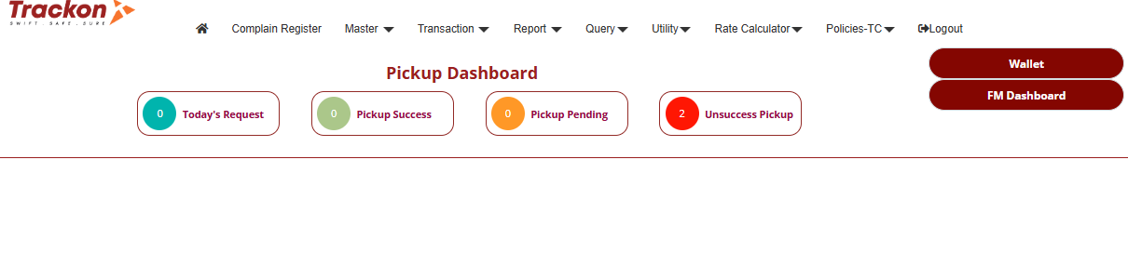
WELCOME TO BA PORTAL
Ba Portal
We provide a safe, diverse and rewarding environment to work

Slide 4

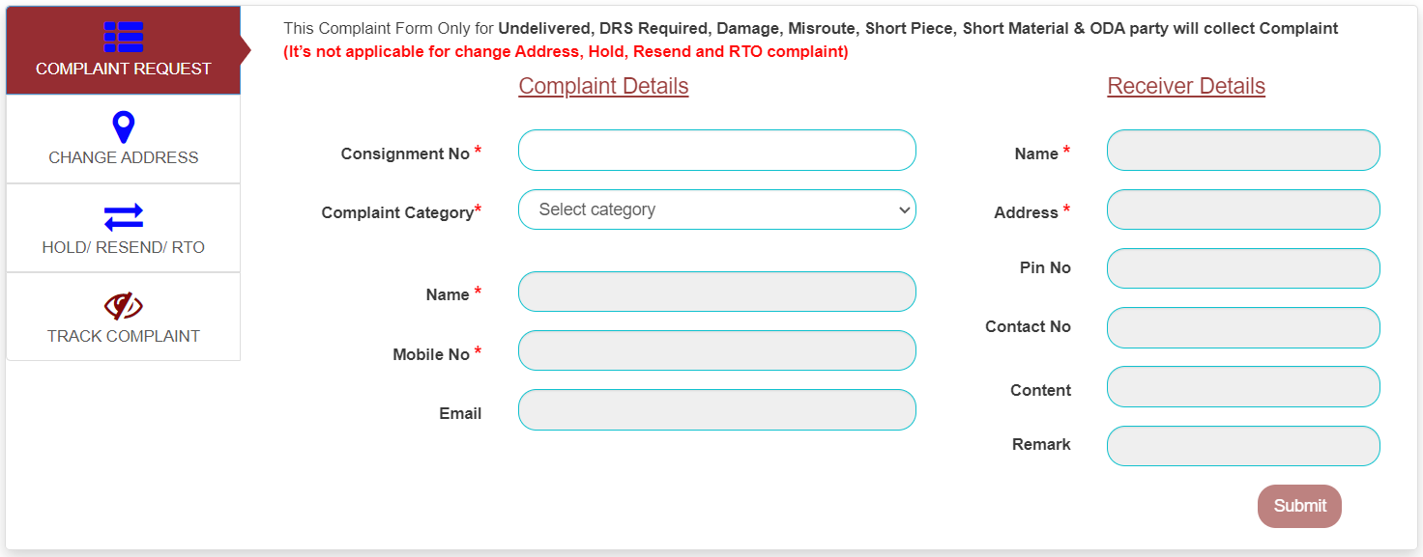
Complain Register
After the shipment is booked by the Ba Users . In case the shipment is not delivered within 72 hours, if there is any other requirement related from the shipment , then the Ba user can log his complaint here. Our Backend team is always ready to fulfill your requirement .
Ba Portal
We provide a safe, diverse and rewarding environment to work

Slide 5

MASTER MENU
Ba Portal
We provide a safe, diverse and rewarding environment to work

Slide 6
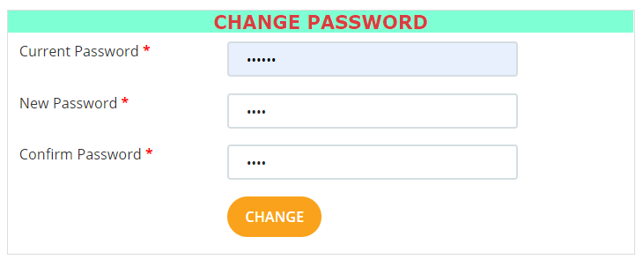
CHANGE PASSWORD
Ba Portal
We provide a safe, diverse and rewarding environment to work

Slide 7
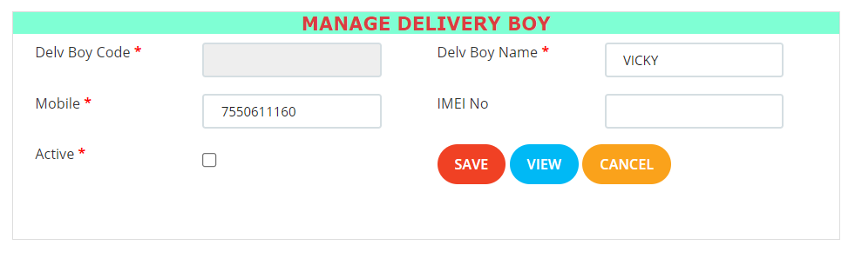

MANAGE DELIVERY BOY
After SAVE Delivery Boy Code Generated Automatically
Ba Portal
We provide a safe, diverse and rewarding environment to work

Slide 8
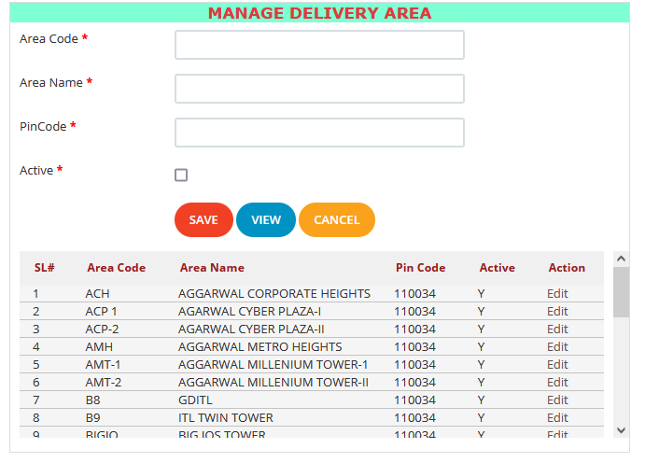
MANAGE DELIVERY AREA
Ba Portal
We provide a safe, diverse and rewarding environment to work

Slide 9
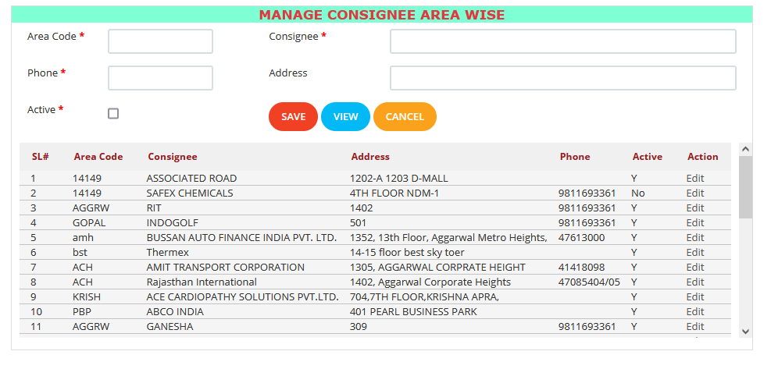
MANAGE CONSIGNEE AREA WISE
Ba Portal
We provide a safe, diverse and rewarding environment to work

Slide 10
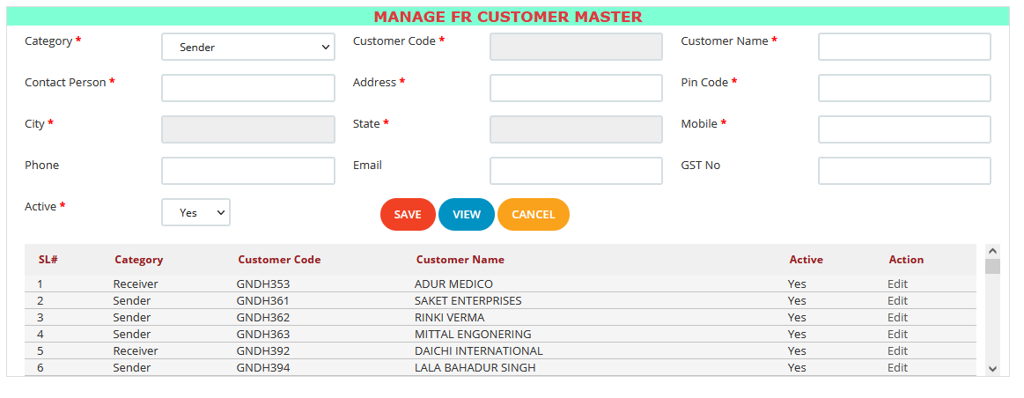
MANAGE FR CUSTOMER MASTER
Ba Portal
We provide a safe, diverse and rewarding environment to work

Slide 11
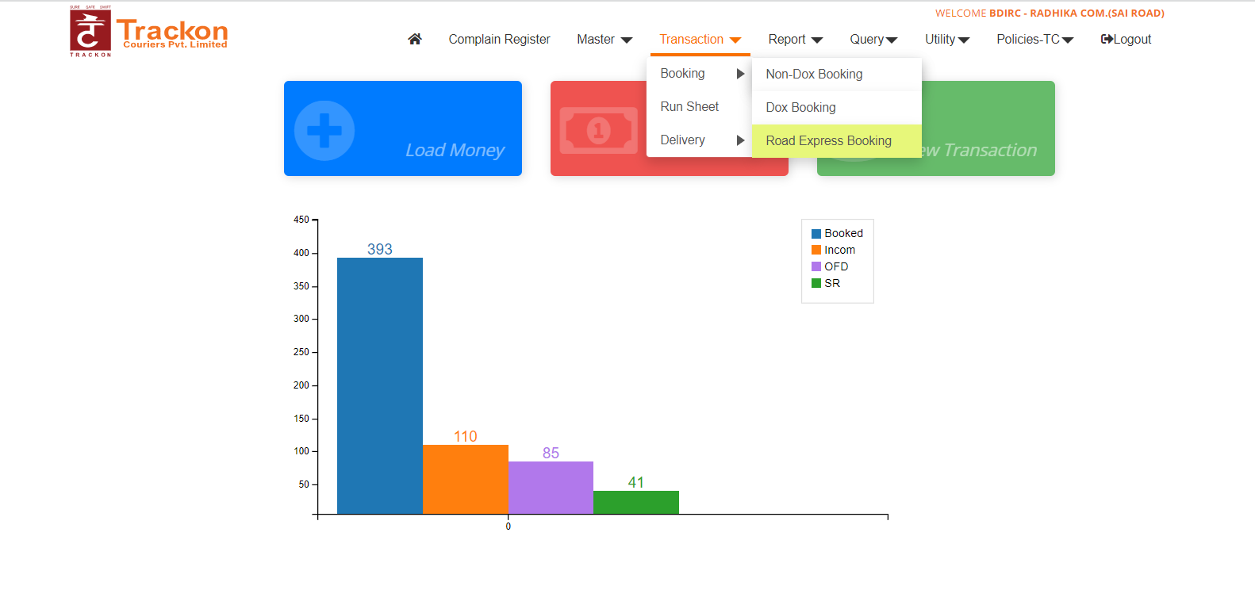
TRANSACTION MENU
Ba Portal
We provide a safe, diverse and rewarding environment to work

Slide 12

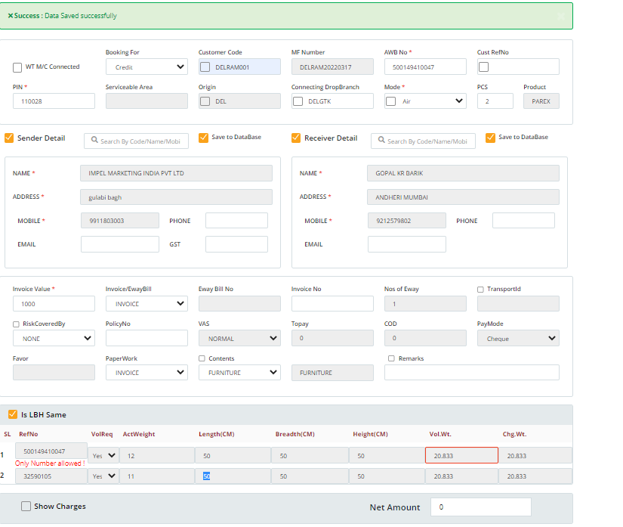

BOOKING
NON-DOX BOOKING
Ba Portal

Slide 13
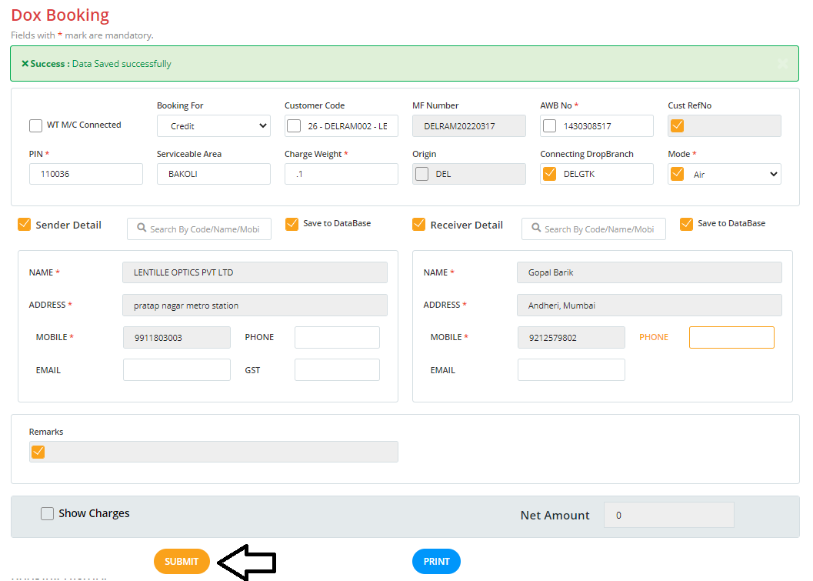
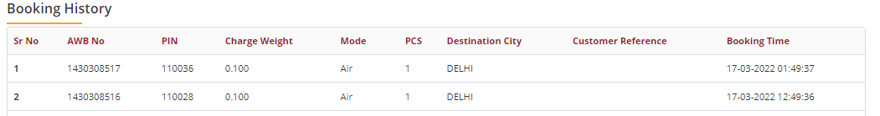
BOOKING
DOX BOOKING
Ba Portal

Slide 14
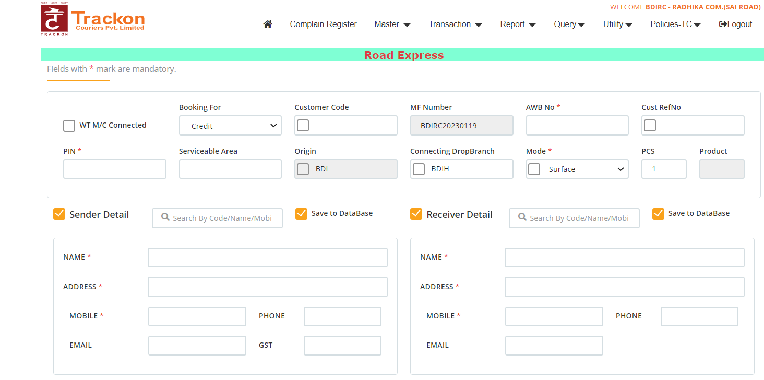
Road Express Booking
Part - 1
Once you click on the Road Express Booking you will see the screen like this
Note: All the fields with * are mandatory
Ba Portal

Slide 15
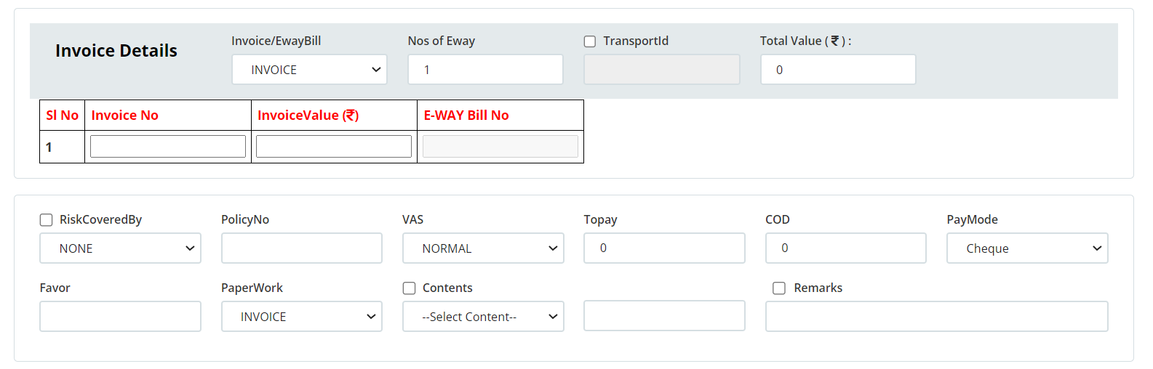
Road Express Booking
Part - 2
Select invoice or E way bill and Enter the number of E ways
If you selected the E way bill from drop down it is mandatory to enter the E Way Bill Number
Note: In below invoice details table all the fields are mandatory if select only invoice from drop down no need to enter E way Bill Number.
Select Invoice Or E way Bill
Enter Number of E way Bill
Ba Portal

Slide 16
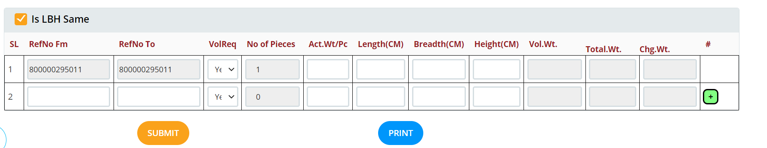
Road Express Booking
Part - 3
Once you enter the number of pieces in pcs text box the below table will generate and it will take 1St Ref Num From and Ref To as AWB number and if have multiple pieces and we can click on + add new row and enter the Ref Form and Ref To
Note : Reference To should not be less than Reference From .And all the fields in table are mandatory to fill
Enter the reference number to
No of pieces will come automatically by difference between Ref From and Ref To
Enter the reference number from
Click here to add new row
Click here to Submit the Road Express Booking
Ba Portal

Slide 17
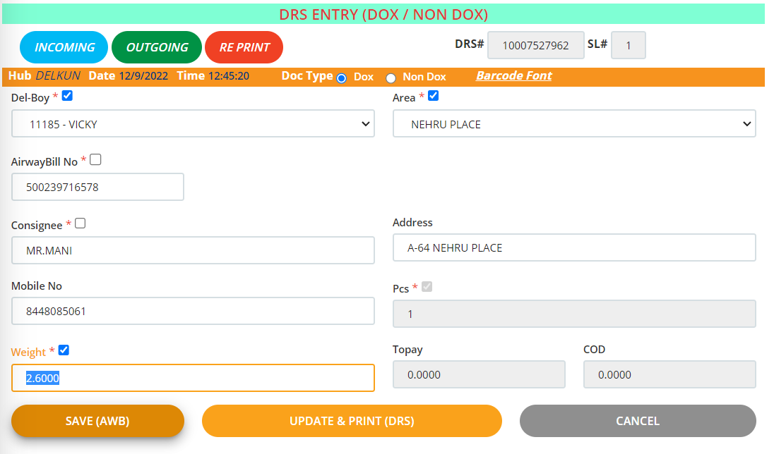
SYSTEM GENERATED DRS
Run sheet
Part-1
Ba Portal
We provide a safe, diverse and rewarding environment to work

Slide 18
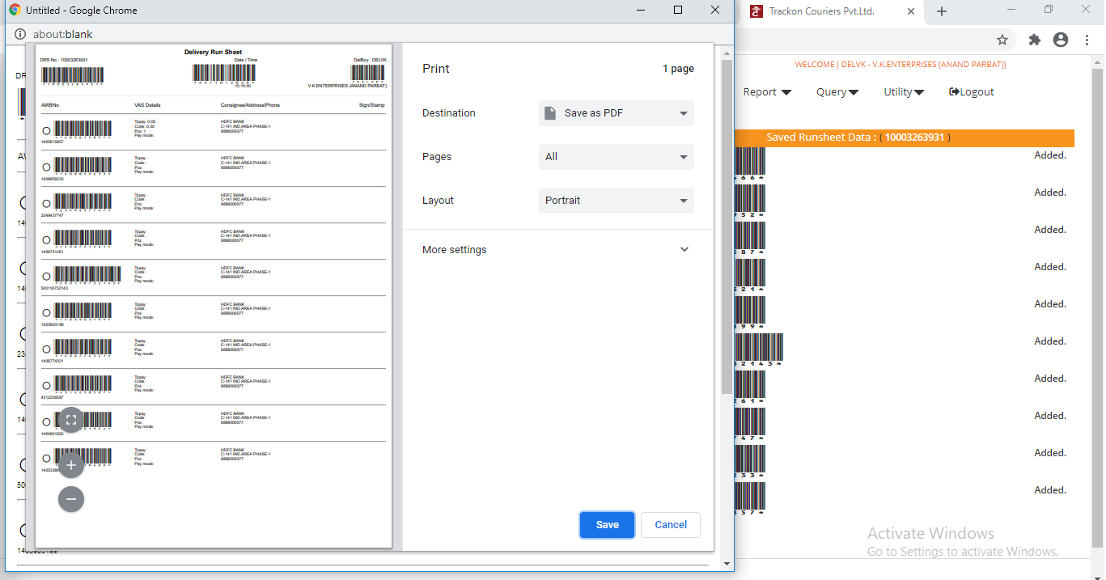
SYSTEM GENERATED DRS
Run sheet
System will give Auto Print on Submit of DRS
Part-2
Ba Portal
We provide a safe, diverse and rewarding environment to work

Slide 19
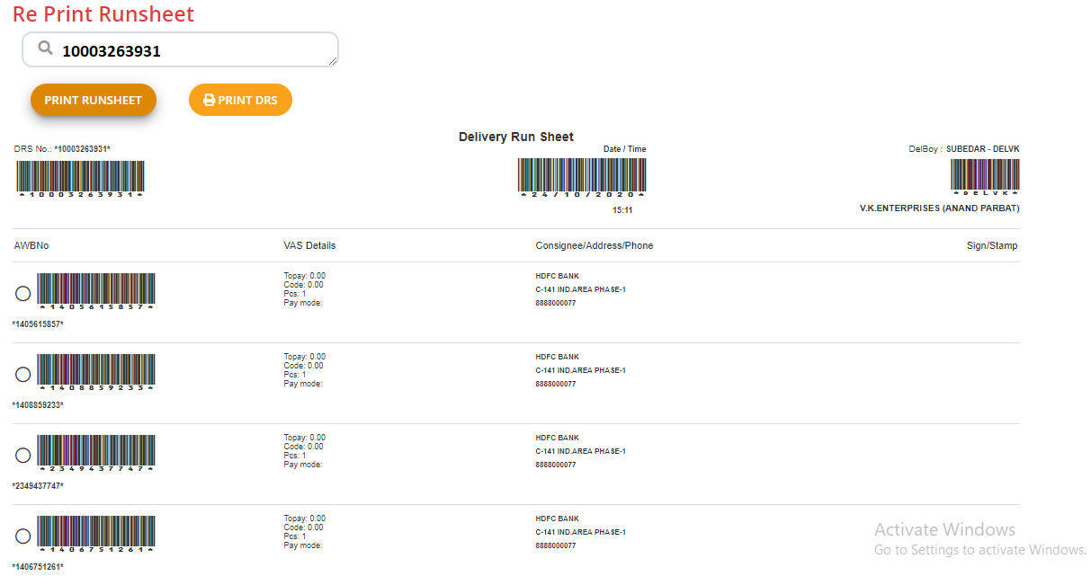
SYSTEM GENERATED DRS
Run sheet
Part-3
DRS MANUAL PRINT
Ba Portal
We provide a safe, diverse and rewarding environment to work

Slide 20
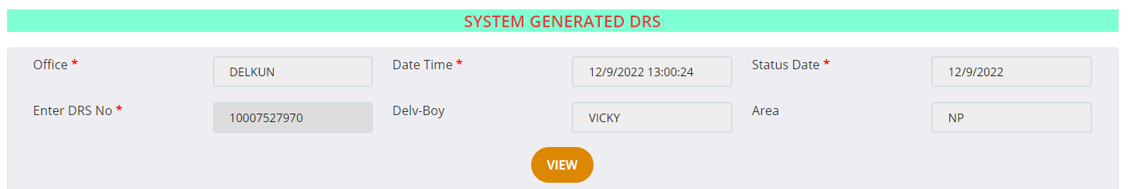
SYSTEM GENERATED DRS
Status update
Part-1
The shipments that have been delivered by the deliver boy of the branch. Branch can update the status on the basis of the DRS number
Click To Submit
Ba Portal
We provide a safe, diverse and rewarding environment to work

Slide 21
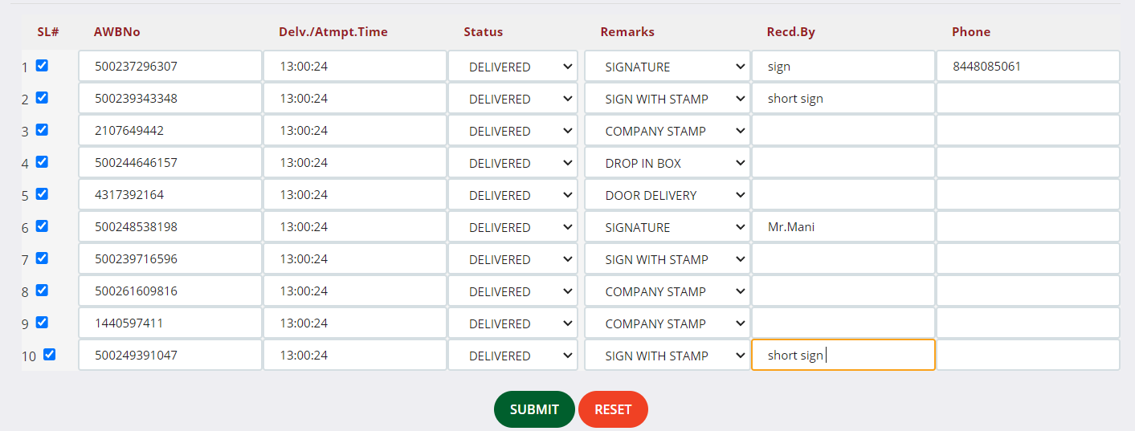
SYSTEM GENERATED DRS
Status update
Part-2
The shipments delivered by the Branch Del-boy and signed on DRS have to be filled here by the receiver who has Received That shipments.
Click To Submit
Ba Portal
We provide a safe, diverse and rewarding environment to work

Slide 22
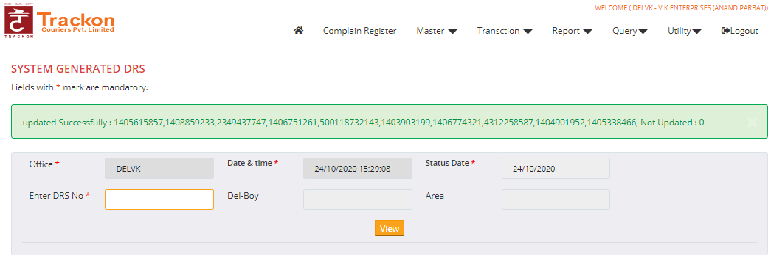
SYSTEM GENERATED DRS
Status update
Part-3
Once Submitted, system will generate the DRS and open new DRS generation option
Ba Portal
We provide a safe, diverse and rewarding environment to work

Slide 23
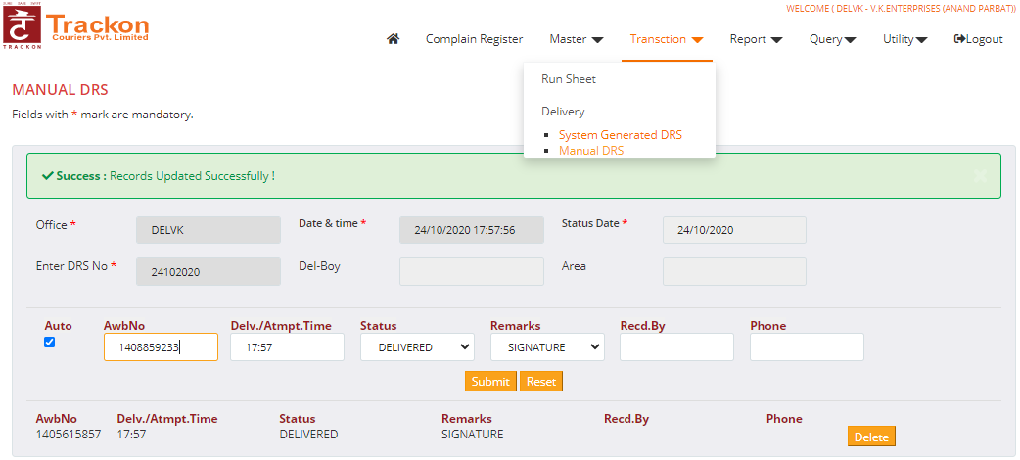
MANUAL DRS
Status update
Select status date - Enter manual DRS No - Enter manual Awbno of the DRS - Select status, Remarks and entry Recd.by and Phone NO. Then click the Submit button.
Then Awbno row will Drop down as per the below image. In this process you can enter 20 AWB NO (Max) in a manual DRS. In case of wrong entry you can Delete it.
Ba Portal
We provide a safe, diverse and rewarding environment to work

Slide 24
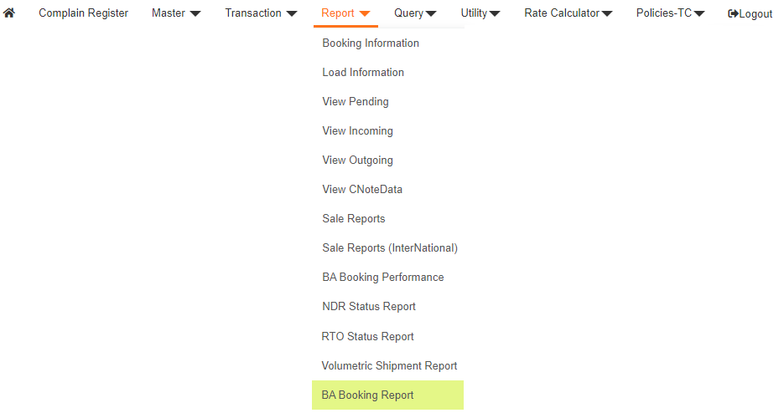
REPORT MENU
Ba Portal
We provide a safe, diverse and rewarding environment to work

Slide 25
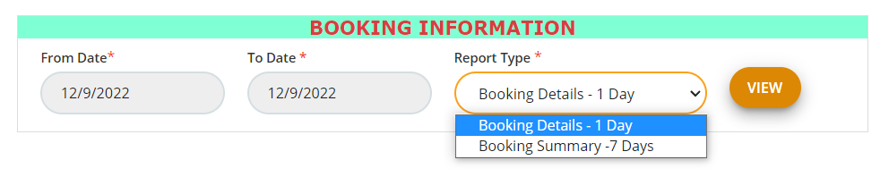
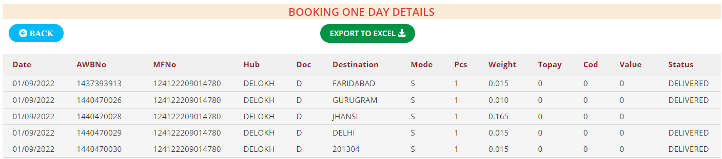
BOOKING INFORMATION
Designee to details of booked shipments by Branch
Ba Portal
We provide a safe, diverse and rewarding environment to work

Slide 26
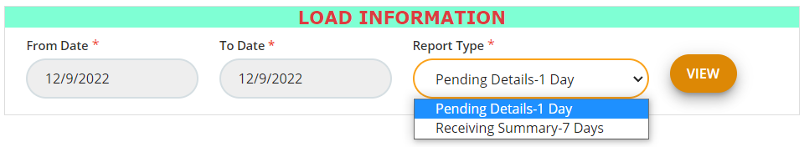
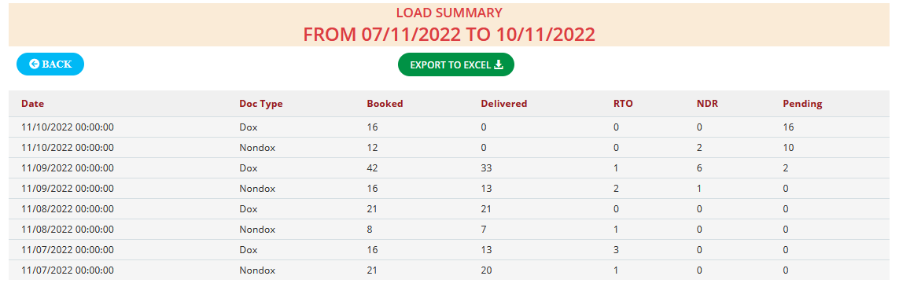
LOAD INFORMATION
Ba Portal
We provide a safe, diverse and rewarding environment to work

Slide 27
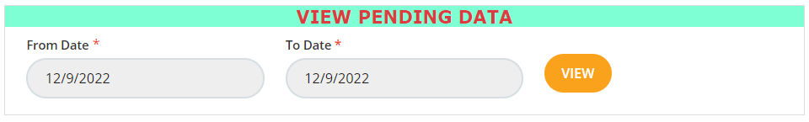
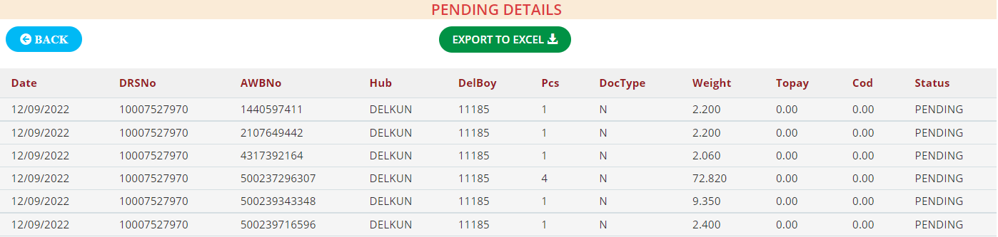
VIEW PENDING DATA
Ba Portal
We provide a safe, diverse and rewarding environment to work

Slide 28
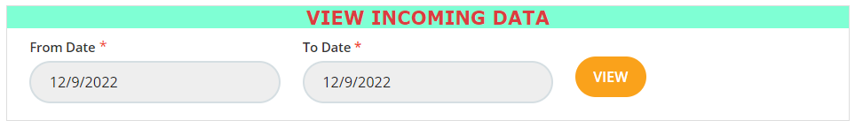
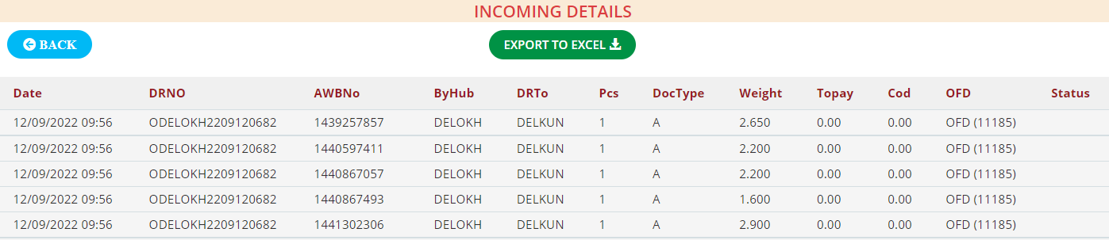
VIEW INCOMING DATA
Ba Portal
We provide a safe, diverse and rewarding environment to work

Slide 29

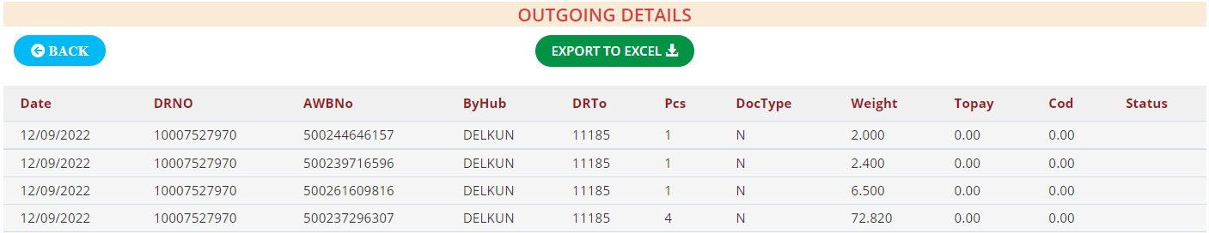
VIEW OUTGOING DATA
Ba Portal
We provide a safe, diverse and rewarding environment to work

Slide 30
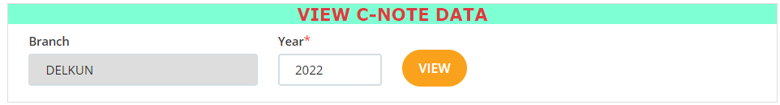
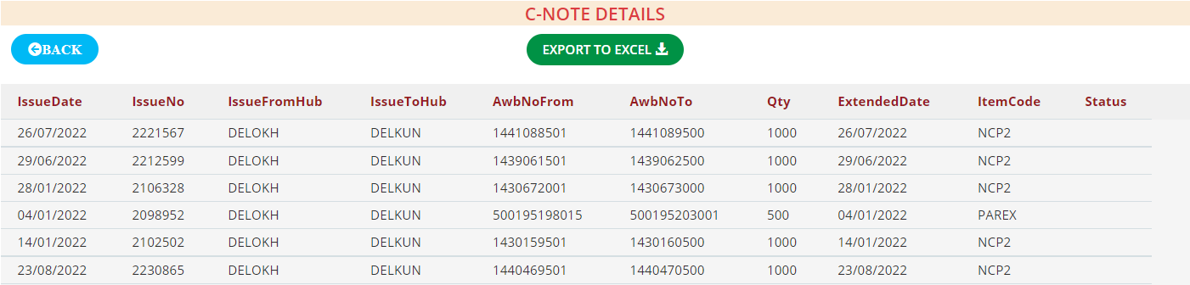
VIEW C-NOTE DATA
Ba Portal
We provide a safe, diverse and rewarding environment to work

Slide 31
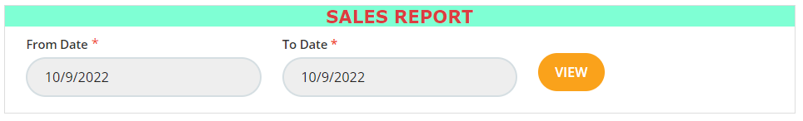
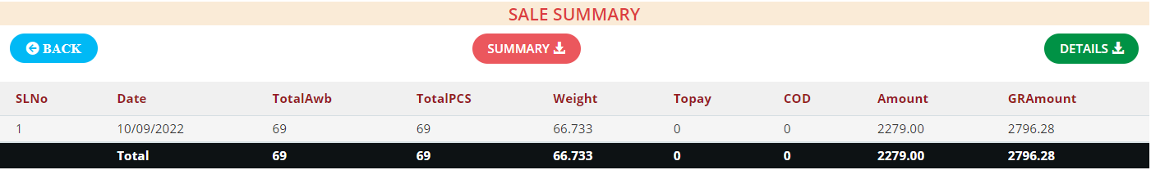
SALES REPORT
Ba Portal
We provide a safe, diverse and rewarding environment to work

Slide 32
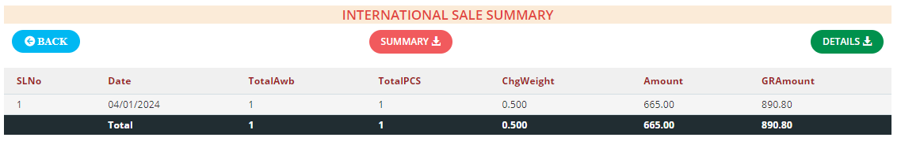
SALES REPORT (INTERNATIONAL)
Ba Portal
We provide a safe, diverse and rewarding environment to work

Slide 33
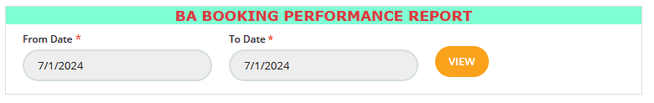
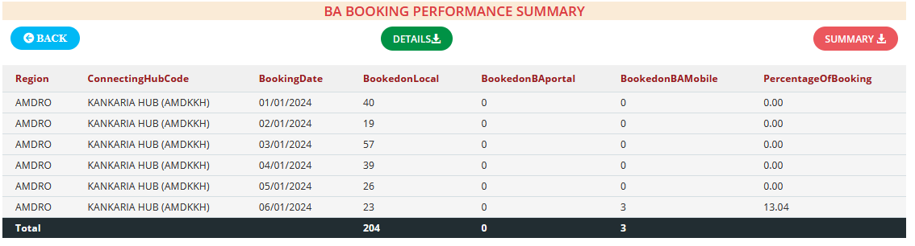
BA BOOKING PERFORMANCE REPORT
Designee to show the details of BA Booking Vs BaMobile Booking Vs Local Booking Performance
Ba Portal
We provide a safe, diverse and rewarding environment to work

Slide 34
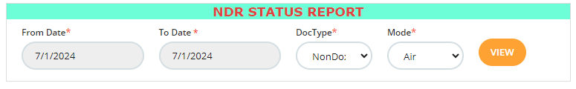
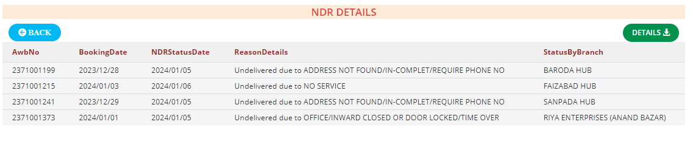
NDR STATUS REPORT
Designee to show the details of NDR Status Entry shipments & From Date and To Date parameters indicate when the status was applied against the shipment in this date range.
Ba Portal
We provide a safe, diverse and rewarding environment to work

Slide 35
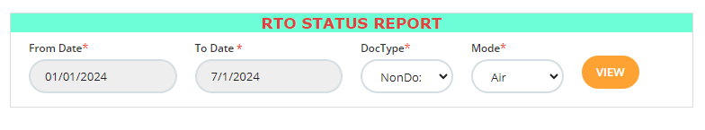
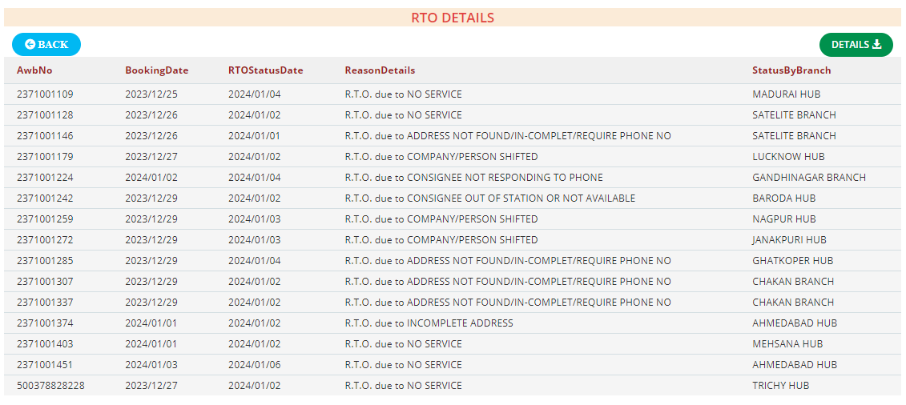
RtO Status REPORT
Designee to show the details of RTO Status Entry shipments & the From Date and To Date parameters indicate when the status was applied against the shipment in this date range.
Ba Portal
We provide a safe, diverse and rewarding environment to work

Slide 36
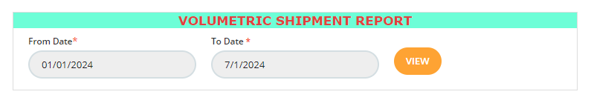
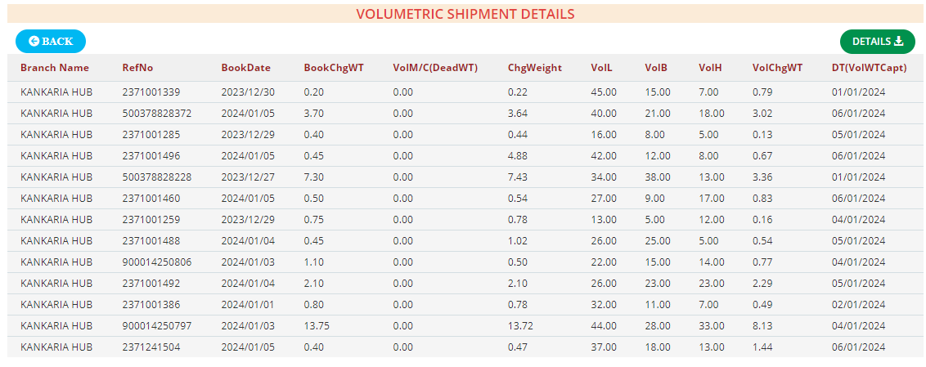
VOLUMETRIC SHIPMENT REPORT
Designee to show the details of Change Volumetric shipments Weight
Ba Portal
We provide a safe, diverse and rewarding environment to work

Slide 37
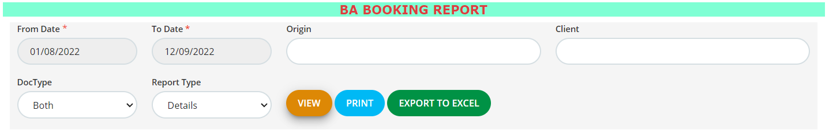
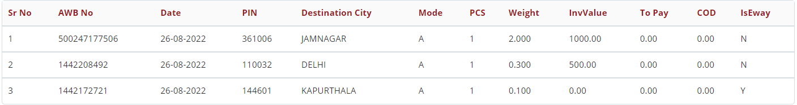
BA BOOKING REPORT
Designee to show the details of booked shipments in BA Portal
Ba Portal
We provide a safe, diverse and rewarding environment to work

Slide 38
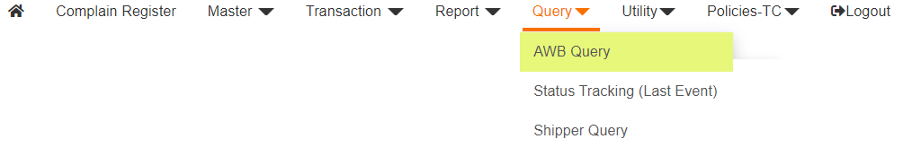
QUERY MENU
Ba Portal
We provide a safe, diverse and rewarding environment to work

Slide 39

SHIPMENT STATUS
Ba Portal
We provide a safe, diverse and rewarding environment to work

Slide 40

SHIPMENT LAST STATUS
Ba Portal
We provide a safe, diverse and rewarding environment to work

Slide 41

SHIPPER STATUS
Ba Portal
We provide a safe, diverse and rewarding environment to work

Slide 42

UTILITY MENU
Ba Portal
We provide a safe, diverse and rewarding environment to work

Slide 43


UTILITY MENU
Ba Portal
We provide a safe, diverse and rewarding environment to work

Slide 44

UTILITY MENU
Ba Portal
We provide a safe, diverse and rewarding environment to work

Slide 45

DOWNLOAD SERVICEABLE PINCODE
Ba Portal
We provide a safe, diverse and rewarding environment to work

Slide 46


DOWNLOAD INVOICE / BILL
Ba Portal
We provide a safe, diverse and rewarding environment to work

Slide 47

INTERNATIONAL RATE CALCULATOR
Ba Portal
We provide a safe, diverse and rewarding environment to work

Slide 48

POLICIES - TC MENU
Ba Portal
We provide a safe, diverse and rewarding environment to work

Slide 49

TERMS & CONDITION
Ba Portal
We provide a safe, diverse and rewarding environment to work

Slide 50

REFUND & CANCELLATION POLICY
Ba Portal
We provide a safe, diverse and rewarding environment to work

