Slide 1
BA Enhancement

Slide 2
BA Enhancements
New DRS Generation
New DRS Updation
POD / DRS scanning & upload

Slide 3
Enhancement
Present scenario, industry is moving towards digitalisation and its well needed service requirement by customers. We already began this journey by launching ‘PARCEL Express’, hence scanning POD and allow view/download.
Our biggest force, ‘Franchisees’ who all are last mile also need to support this feature. Hence we launched tool on BA portal, what all DRS (System or Manual) are UPDATED by Franchisee on BA, will be allow to scan DRS for same.
All Scanned DRS image will get assigned to the delivered s/ments and will get POD image view option.
This will not only reduce the pressure on the regional scanning team but also speed up the process of scanning.
NO need of storing physical DRS copies

Slide 4
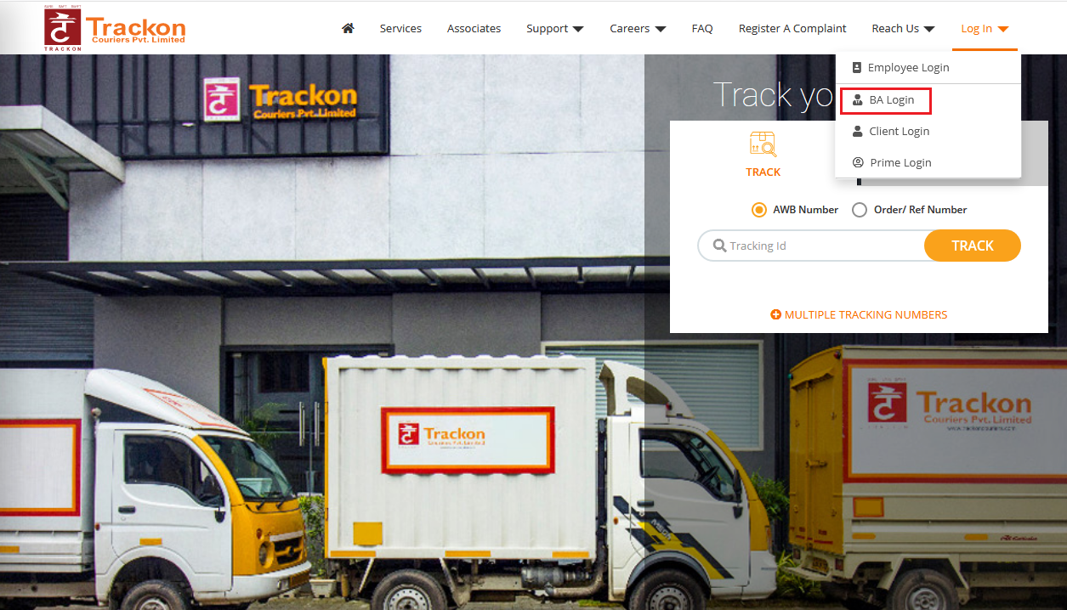
http://ba.trackon.in/
BA LOGIN PAGE

Slide 5
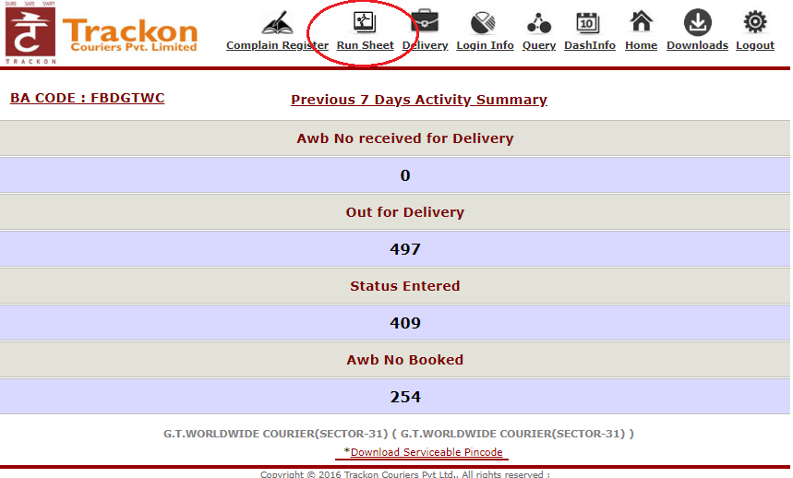
http://ba.trackon.in/
BA HOME PAGE

Slide 6
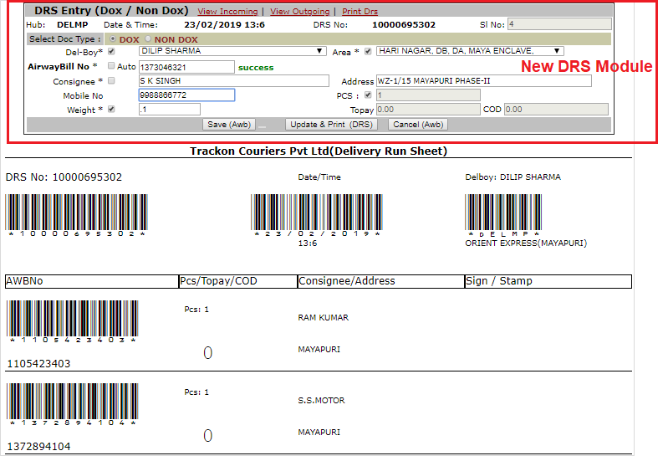
http://ba.trackon.in/
NEW DRS ENTRY Module (DOX / NDOX)

Slide 7
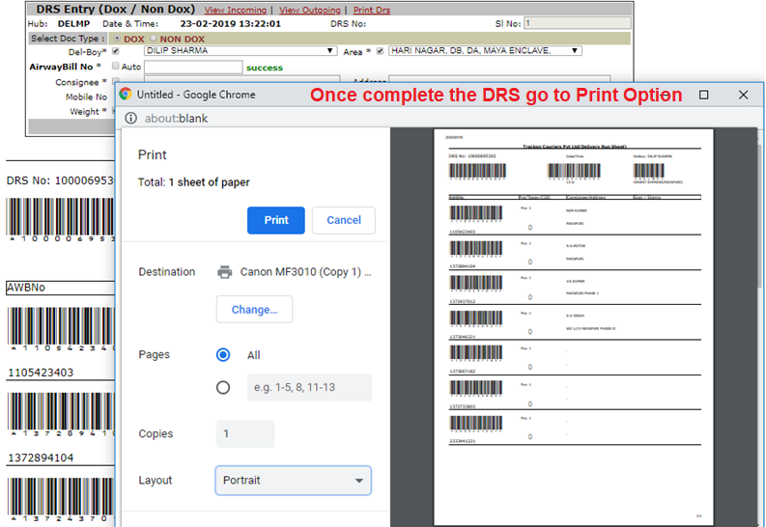
http://ba.trackon.in/
NEW DRS ENTRY - PRINT OUT

Slide 8
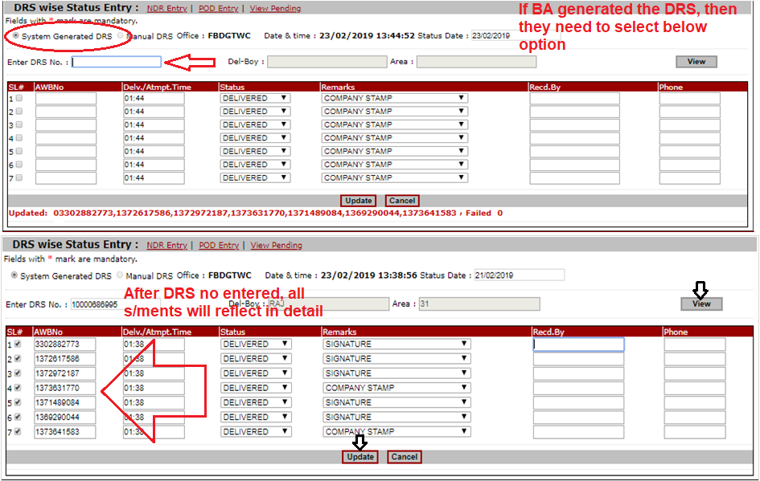
http://ba.trackon.in/
NEW DRS UPDATION Module

Slide 9
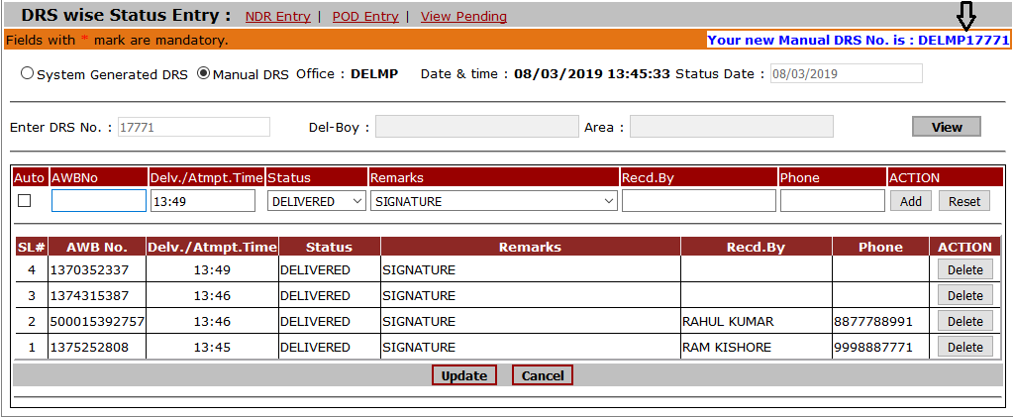
http://ba.trackon.in/
BA MANUAL DRS UPDATION
Select status date than Enter manual DRS No. than enter all awbno of the DRS and check the Sl.no box for auto updating other wise you update manual select status, Remarks and entry Recd.by and Phone then click the add button then AWBno will Drop down as per the below image in this process you can Maximum enter 20 AWB NO in a manual DRS. after entry click update button.

Slide 10
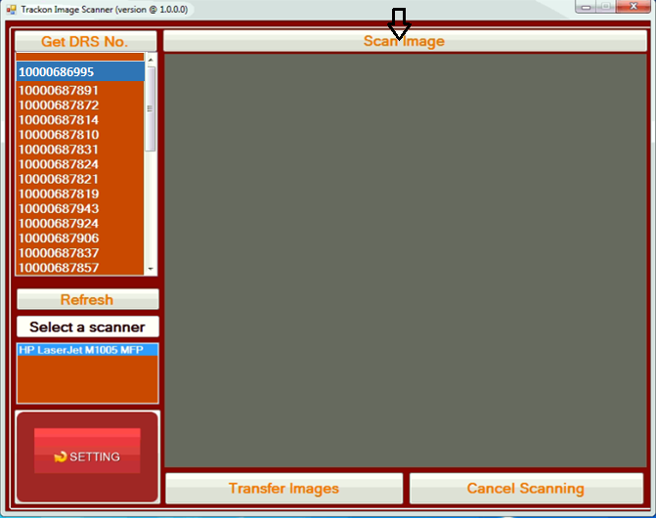
Scanning Utility
Start the EXE installed I the local system once all the DRS are updates

Slide 11
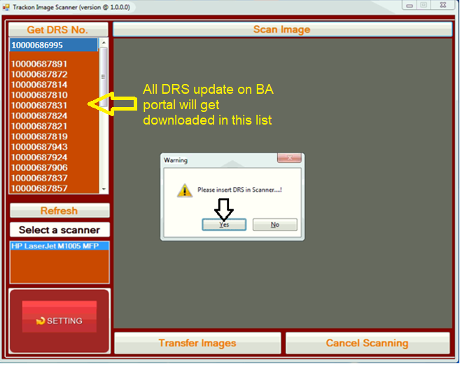
Scanning Utility
Switch on the Scanner Select the System Generated DRS Number which you want to Scan.
Insert the same DRS Sheet in the Scanner Click yes of the warning page then the Scanning process will start and after Scanning the DRS will Display on the screen.

Slide 12
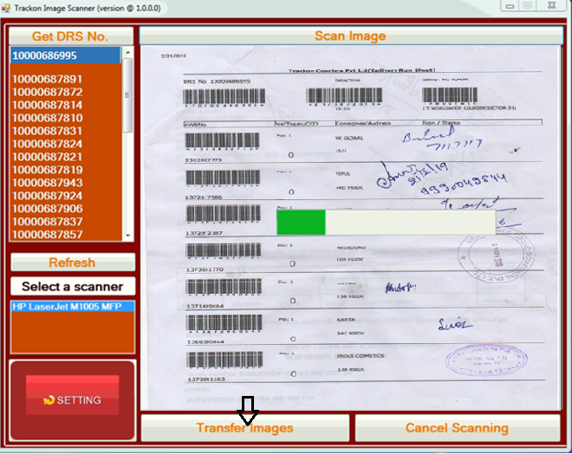
Scanning Utility
Click Transfer image than image transfer process will start after the process complete give message Image transfer completed

Slide 13
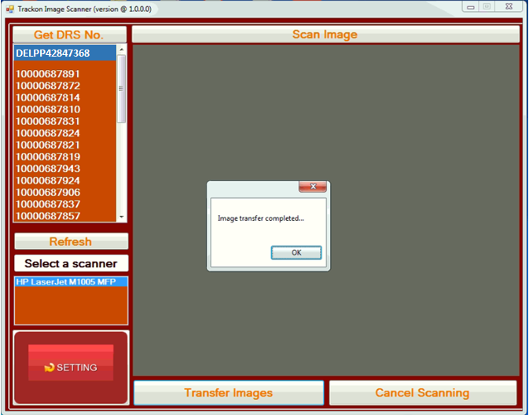
BA IMAGE DATA TRASFER
EXE in local system to Scan image

Slide 14
Installation Guide

Slide 15
EXE Installing Process
Prerequisite:
The franchise should have All in one printer with scanner (cannon, HP, Other) or Scanner.
Franchise should be using BA portal, generating DRS for self and update DRS.
Operating system (Window 7, window 8 or More Advance).
Installation Process:
Download .NET 4.5 (http://download.microsoft.com/download/1/A/F/1AF0211E-69A7-4B58-8189-8BA9014AE03A/enu_netfx/x86/dotnetfx45_full_setup.exe)
Create a new folder (PODDRSScan) in your computer in secondary drive (D / E) and create another folder inside PODDRSScan folder and give folder name (ScannedImg).
Open Debug folder and install (setup.exe) and give Browsing path of the existing Folder (D:\ PODDRSScan \ ScannedImg) and finish it then open the existing folder and open the exe (TrackonImageScanner) then Start Scan.

Slide 16
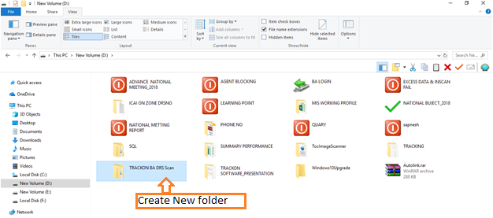
EXE Installing Process

Slide 17
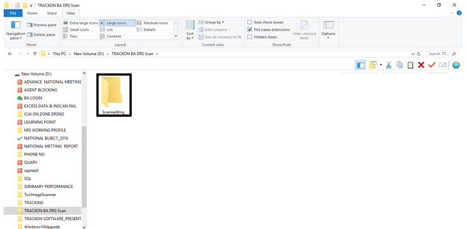
EXE Installing Process

Slide 18
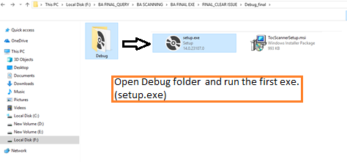
EXE Installing Process

Slide 19
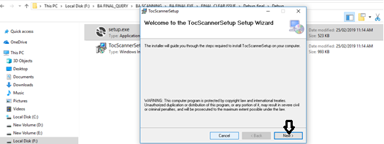
EXE Installing Process

Slide 20
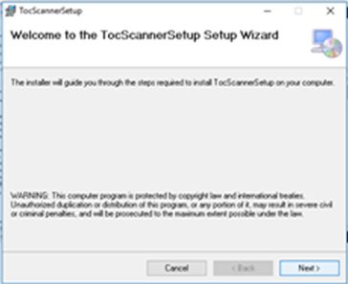
EXE Installing Process

Slide 21
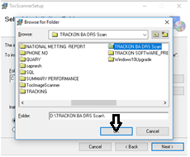
EXE Installing Process

Slide 22
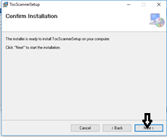
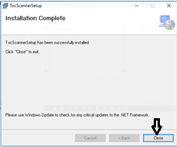
EXE Installing Process

Slide 23
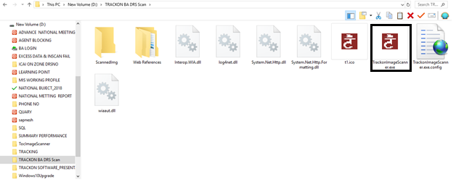
Execute / Start Scanning

Slide 24
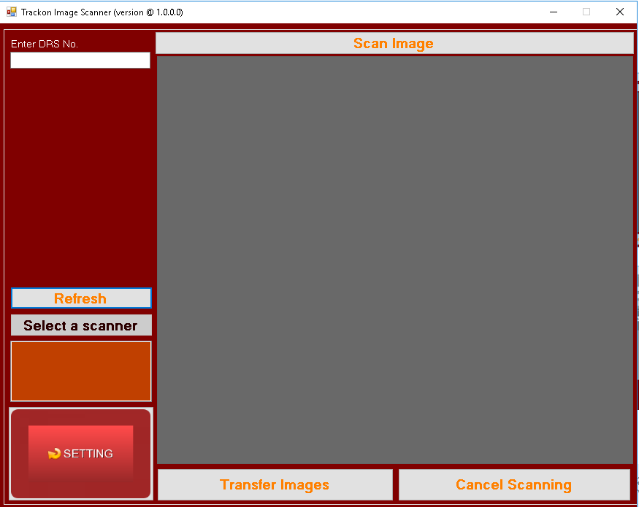
LOCAL BRANCH/ BA DRS EXE SETTING
After Installation, Click on the Setting Button

Slide 25
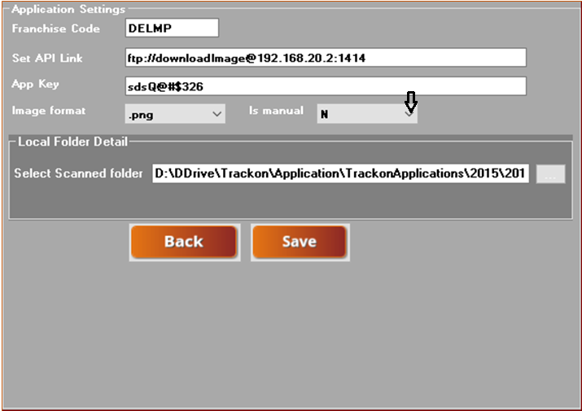
LOCAL BRANCH/ BA DRS EXE SETTING
For local branch Scanning Is manual select (Y) and for BA select (N)

Slide 26
THANKS

