Slide 1
BA Booking Module

Slide 2
Enhancement in BA Portal
We are glad to inform that we developed BA booking for dox and Nondox module. It is convenient, time saving & captured more information for our operation. It is complete mobile enabled new look & features.
This data will help to franchisee for their billing purposes.
Once you all will start using then we will launch many new features.

Slide 3
Enhancement in BA Portal
Below are the modules made Online
Customer Master
Dox Booking Module
Ndox Booking Module
Report of Booking
Save Sender & Receiver detail, so next time you can search for repeated customer

Slide 4
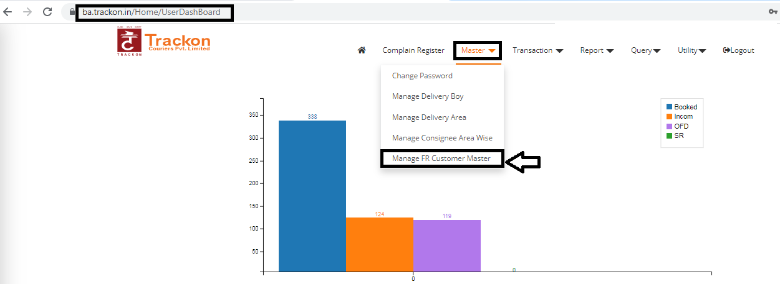
Enhancement in BA Portal
Create Your sender & receiver details it will helps for booking faster as entire detail will auto reflect

Slide 5
Enhancement in BA Portal

Slide 6
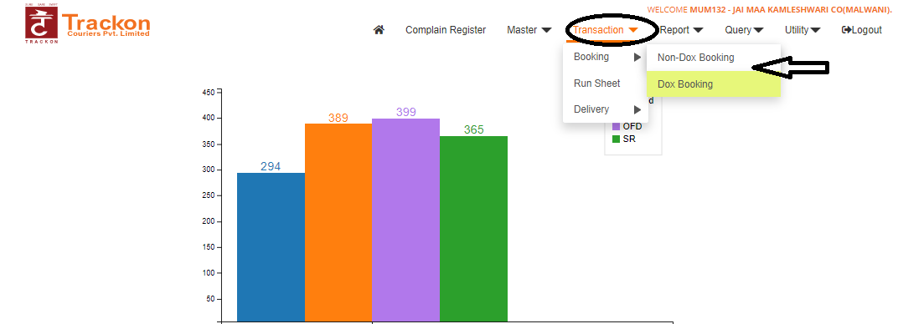
Enhancement in BA Portal

Slide 7
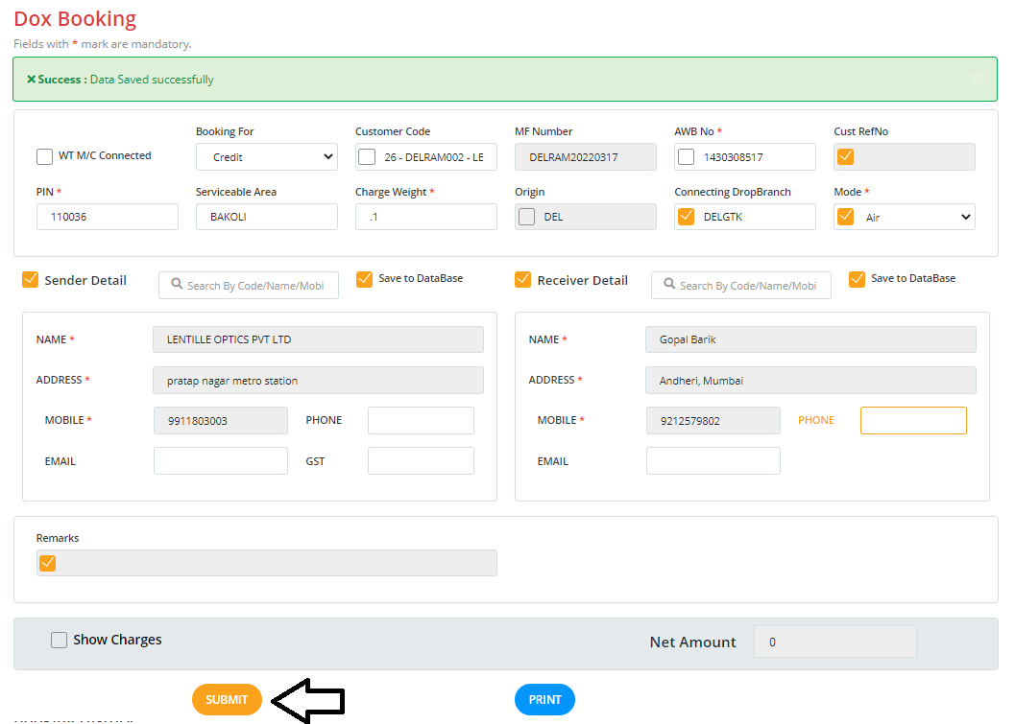
Enhancement in BA Portal

Slide 8
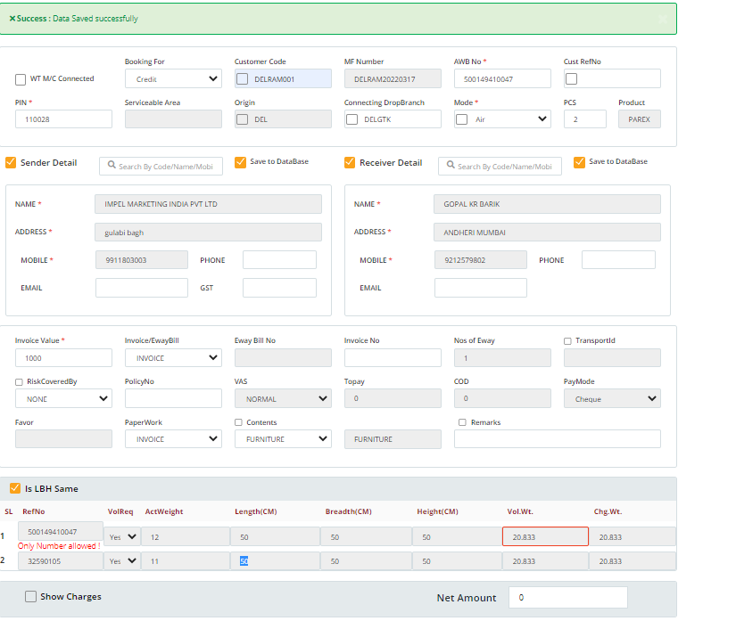
Enhancement in BA Portal

Slide 9
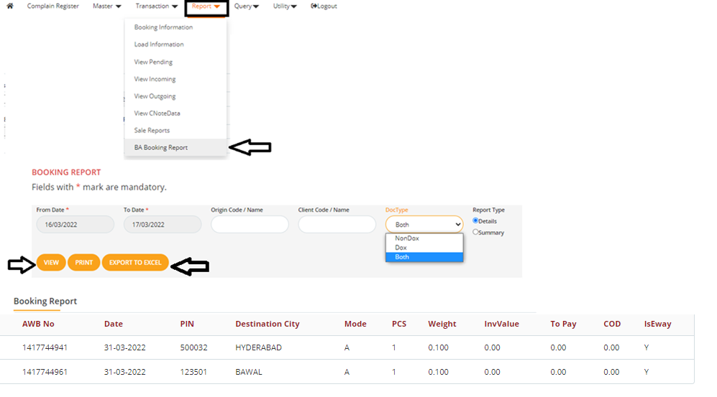
Enhancement in BA Portal
Booking report

Slide 10
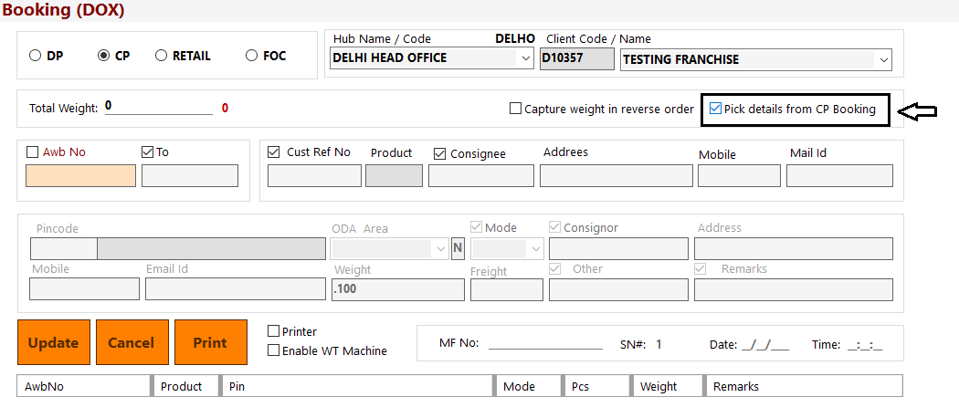
Franchisee Receiving Dox (Hub Office)

Slide 11
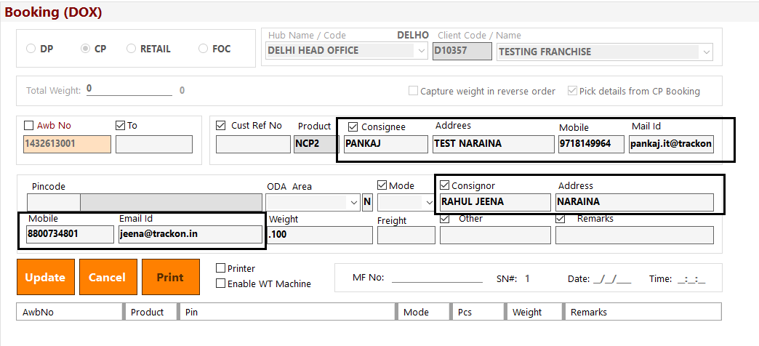
Dox Sender and receiver auto details system will ask only pincode,mode and weight

Slide 12
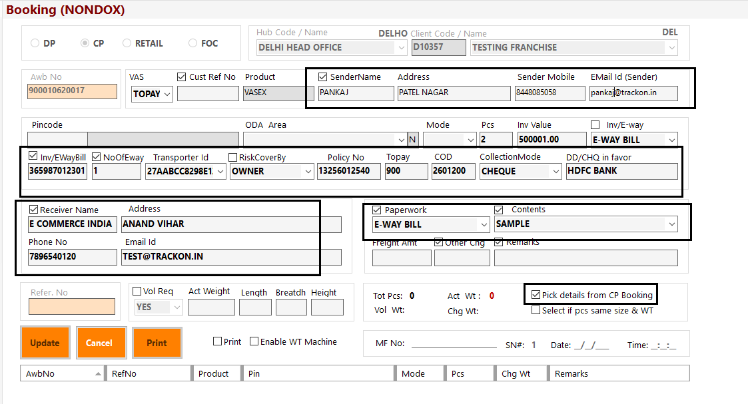
N/Dox Sender , receiver auto details paper work and vas details system will ask only pincode,mode and weight

Slide 13
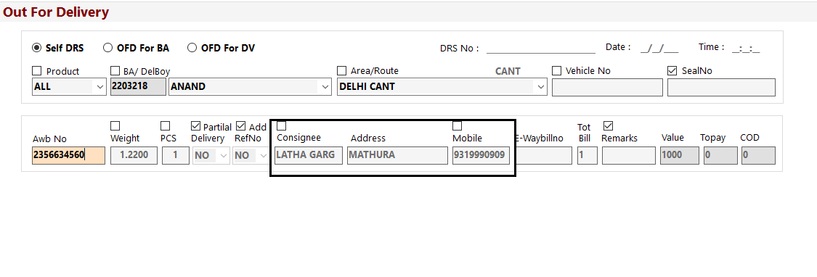
At the time of OFD consignee Details From Booking

Slide 14
Thank You

